Slide 1
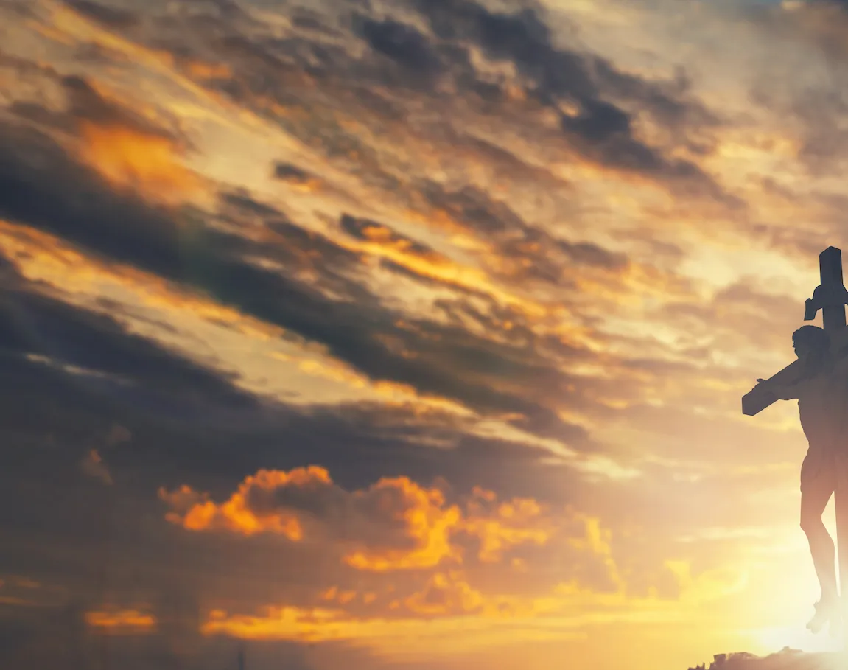
Give Us Clean Hand

Slide 2
G D
We bow our hearts, we bend our knees
C G
Oh Spirit come and make us humble
G D
We turn our eyes from evil things
C
Oh Lord we cast down our idols

Slide 3
G
Give us clean hands
D
Give us pure hearts
Em D G
Let us not lift our souls to another

Slide 4
G
Give us clean hands
D
Give us pure hearts
Em D C
Let us not lift our souls to another

Slide 5
G
O God, let us be
D
A generation that seeks
Em
seeks Your face
D G
O God of Jacob

Slide 6
G
O God, let us be
D
A generation that seeks
Em
seeks Your face
D C
O God of Jacob

Slide 7
G D
We bow our hearts, we bend our knees
C G
Oh Spirit come and make us humble
G D
We turn our eyes from evil things
C
Oh Lord we cast down our idols

Slide 8
G
Give us clean hands
D
Give us pure hearts
Em D G
Let us not lift our souls to another

Slide 9
G
Give us clean hands
D
Give us pure hearts
Em D C
Let us not lift our souls to another

Slide 10
G
O God, let us be
D
A generation that seeks
Em
seeks Your face
D G
O God of Jacob

Slide 11
G
O God, let us be
D
A generation that seeks
Em
seeks Your face
D C
O God of Jacob

Slide 12
Instrumental
G / D / C / G
G / D / C / G

Slide 13
G
Give us clean hands
D
Give us pure hearts
Em D G
Let us not lift our souls to another

Slide 14
G
Give us clean hands
D
Give us pure hearts
Em D C
Let us not lift our souls to another

Slide 15
G
O God, let us be
D
A generation that seeks
Em
seeks Your face
D G
O God of Jacob

Slide 16
G
O God, let us be
D
A generation that seeks
Em
seeks Your face
D C
O God of Jacob x3 and end
END

Slide 17
Take My Life
And Let It Be

Slide 18
C CAPO 5th
C
Take my life and let it be
Am G F
Consecrated, Lord, to Thee.
Am F
Take my moments and my days,
F G
Let them flow in ceaseless praise.
F G C
Let them flow in ceaseless praise

Slide 19
C F
Take my hands, and let them move
Am G F
At the impulse of Thy love;
Am F
Take my feet and let them be
F G
Swift and beautiful for Thee,
F G C
Swift and beautiful for Thee.

Slide 20
C F
Take my voice, and let me sing
Am G F
Always, only, for my King;
Am F
Take my lips, and let them be
F G
Filled with messages from Thee,
F G C
Filled with messages from Thee.

Slide 21
C F
Take my will, and make it Thine;
Am G F
It shall be no longer mine.
Am F
Take my heart; it is Thine own;
F G
It shall be Thy royal throne,
F G C
It shall be Thy royal throne.

Slide 22
C F
Take my love; my Lord, I pour
Am G F
At Thy feet its treasure store.
Am F
Take myself, and I will be
F G
Ever, only, all for Thee,
F G C
Ever, only, all for Thee.
END

Slide 23
Nearer My God To Thee

Slide 24
G C G D
Nearer, my God, to Thee Nearer to Thee
Em C G D G
Even though it be a cross That raiseth me
Em C Em D
Still all my song shall be Nearer, my God, to Thee
G C G D G
Nearer my God to Thee, nearer to Thee

Slide 25
G C G D
Though, like the wanderer The sun gone down
Em C G D G
Darkness be over me My rest a stone
Em C Em D
Yet in my dreams I'd be Nearer, my God, to Thee
G C G D G
Nearer my God to Thee, nearer to Thee

Slide 26
G C G D
Then, with my waking thoughts Bright with Thy praise
Em C G D G
Out of my stony griefs Bethel I'll raise
Em C Em D
So by my woes to be Nearer, my God, to Thee
G C G D G
Nearer my God to Thee, nearer to Thee

Slide 27
G C G D
There in my Father’s home, safe and at rest,
Em C G D G
There in my Savior’s love, perfectly blest;
Em C Em D
Age after age to be Nearer my God to Thee
G C G D G
Nearer my God to Thee, nearer to Thee
END

Slide 28
Above All

Slide 29
CAPO 2nd
C D G
Above all powers, above all Kings
C D G
Above all nature, and all created things
Em D C G
Above all wisdom, and all the ways of man
Am D G
You were here before the world began

Slide 30
C D G
Above all kingdoms, above all thrones
C D G
Above all wonders this world has ever known
Em D C G
Above all wealth and treasures of the earth
Am C B
There's no way to measure what You're worth

Slide 31
G Am D G
Crucified, laid behind a stone
G Am D G
You lived to die, rejected and alone
Em D C G
Like a rose, trampled on the ground
Am G C D G
You took the fall, and thought of me Above all

Slide 32
C D G
Above all powers, above all Kings
C D G
Above all nature, and all created things
Em D C G
Above all wisdom, and all the ways of man
Am D G
You were here before the world began

Slide 33
C D G
Above all kingdoms, above all thrones
C D G
Above all wonders this world has ever known
Em D C G
Above all wealth and treasures of the earth
Am C B
There's no way to measure what You're worth

Slide 34
G Am D G
Crucified, laid behind a stone
G Am D G
You lived to die, rejected and alone
Em D C G
Like a rose, trampled on the ground
Am G C D G
You took the fall, and thought of me Above all
Play x2

Slide 35
Em D C G
Like a rose, trampled on the ground
Am G C D G
You took the fall, and thought of me Above all
END

Slide 36
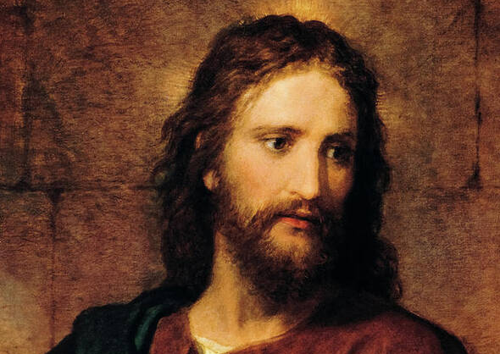
Jesus Paid It All

Slide 37
C
I hear the Savior say,
G C
Thy strength indeed is small,
Am F
Child of weakness, watch and pray,
C G C
Find in Me thine all in all

Slide 38
C Am
Jesus paid it all
C G
All to Him I owe
C F
Sin had left a crimson stain
C G C
He washed it white as snow

Slide 39
C
Lord, now indeed I find
G C
Thy pow'r and Thine alone,
Am F
Can change the leper's spots
C G C
And melt the heart of stone

Slide 40
C Am
Jesus paid it all
C G
All to Him I owe
C F
Sin had left a crimson stain
C G C
He washed it white as snow

Slide 41
C
And when, before the throne
G C
I stand in Him complete
Am F
Jesus died my soul to save
C G C
My lips shall still repeat

Slide 42
C Am
Jesus paid it all
C G
All to Him I owe
C F
Sin had left a crimson stain
C G C
He washed it white as snow

Slide 43
C Am
Jesus paid it all
C G
All to Him I owe
C F
Sin had left a crimson stain
C G C
He washed it white as snow
END

